Slide 1
Example A3
Owner: I.M.N. Trubbel
Team: TBD
Title: Project XYZZY 6-Week Delay Creates $2.1MM Gap
Rev 2/Date: Sept 10
1. Organizational Need
4. Root Causes
Project XYZZY is a critical part of our near-term growth strategy. A six-week delay may sound manageable, but in this case, it creates a projected $2.1MM shortfall in revenue over the next 24 months. That’s a material gap—one that affects our ability to fund key initiatives, meet strategic targets, and deliver on customer expectations.
The deadline to recover that delay is October 15. Missing it doesn’t just impact financials; it affects credibility with both internal stakeholders and external partners. Our customers are counting on this launch. Our teams are aligned and motivated—but they need a clear path.
Single-source firmware vendor lacked schedule transparency
No early warning of delay; issues surfaced only after the delivery date passed.
Tightly coupled test schedule offered no buffer
Integration and validation steps were interdependent, leaving no room for slippage.
Lack of cross-project resource coordination
Competing priorities across teams limited flexibility to shift resources when issues emerged.
5. Proposed Remediation Menu
2. Problem Statement
As Two primary remediation paths are under evaluation:
Hire 3 consultants from High-Tek Consultants
Brings immediate technical capacity to accelerate firmware integration and testing.
Cost: $120K (people cost, fixed fee for duration).
Pros: Quick ramp-up, flexible hours, familiar with our tech stack.
Cons: Requires close coordination with internal teams to avoid overlap or confusion.
License a prebuilt solution from vendor Razzel.
Bypasses internal integration delays by replacing core module with a proven, pre-certified alternative.
Cost: $360K over 4 years (licensing + support).
Pros: Reduces technical risk, faster time to market.
Cons: Higher long-term cost, loss of customization, dependent on external roadmap.
Both options would allow us to meet the October 15 deadline if initiated within the next two weeks. Trade-offs center around cost, flexibility, and long-term ownership.
Drive current state from 24-month revenue of $2.1MM to $4.2MM by mitigating a known 6-week project delay by October 15.
3. Analysis
The current delay began with a missed delivery from a key vendor—an updated firmware package that was due mid-February. That slip created a domino effect: integration work backed up, hardware testing windows collapsed, and we’re now looking at a six-week overall delay.
In the past two months, we made several attempts to recover within existing resources:
The firmware team tried to parallelize validation and integration, but bugs in the early build made that unworkable.
A weekend sprint was organized to regain ground on testing, but a spike in rework costs forced it to pause after week two.
A proposal to pull engineers from Project Zephyr was floated but rejected—Zephyr is on a customer milestone path of its own.
Now, we’re facing the consequence: we will miss the Spring Tech Showcase, a critical opportunity to debut in front of major buyers. One enterprise customer put it bluntly last week: “If this slips past the spring window, we’ll need to reevaluate your fit for our roadmap—we can't afford this level of uncertainty.”
6. Next Steps assuming Option 2. (Option 1 Next Steps is also available)
Sep 10
Sep 17
Sep 24
Oct 1
Oct 8
Oct 15
Firm up solution (prefer Option 2)
Approval to Supply Chain.
Receive training and initial stack
Begin testing
Complete feasibility study
Confirm release to Sales and key customers

Slide 2
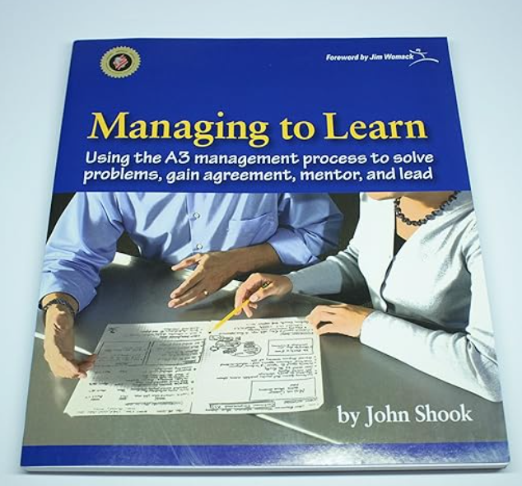

Slide 3
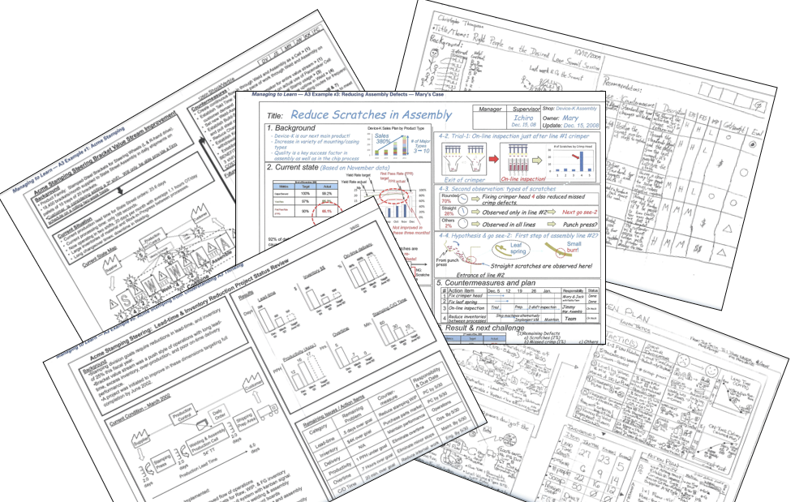
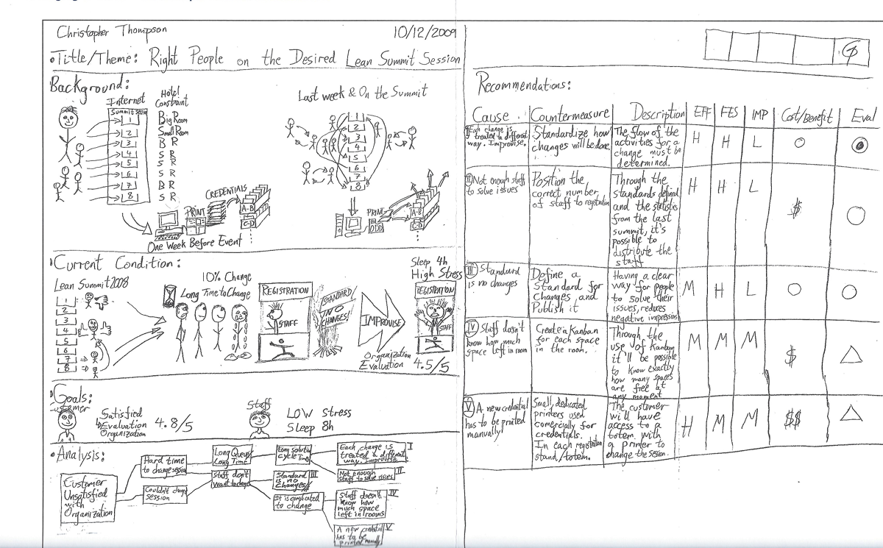
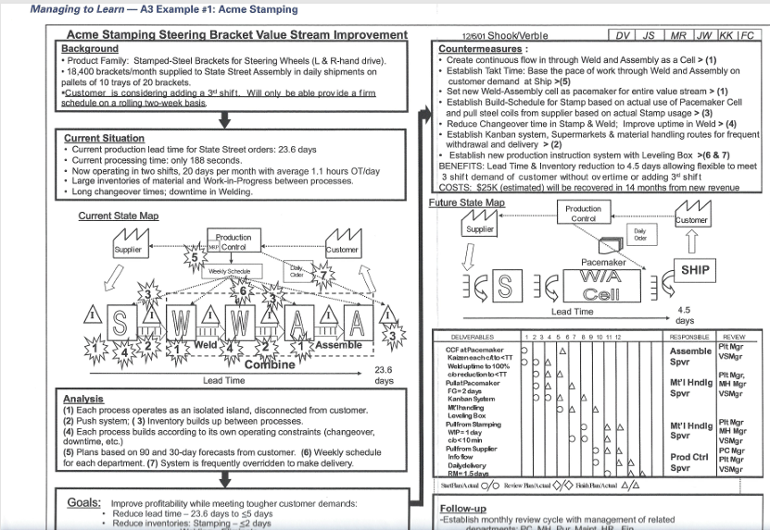
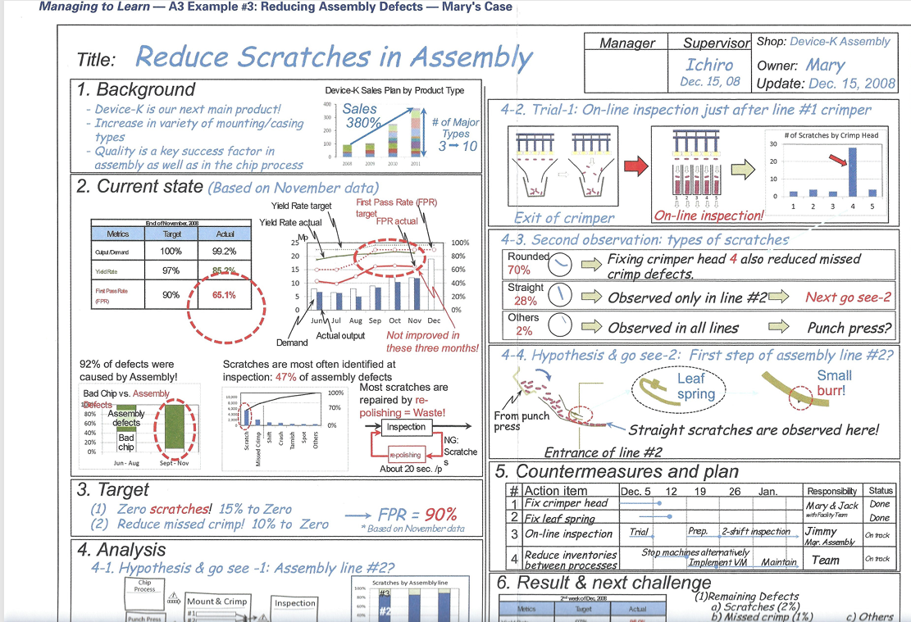
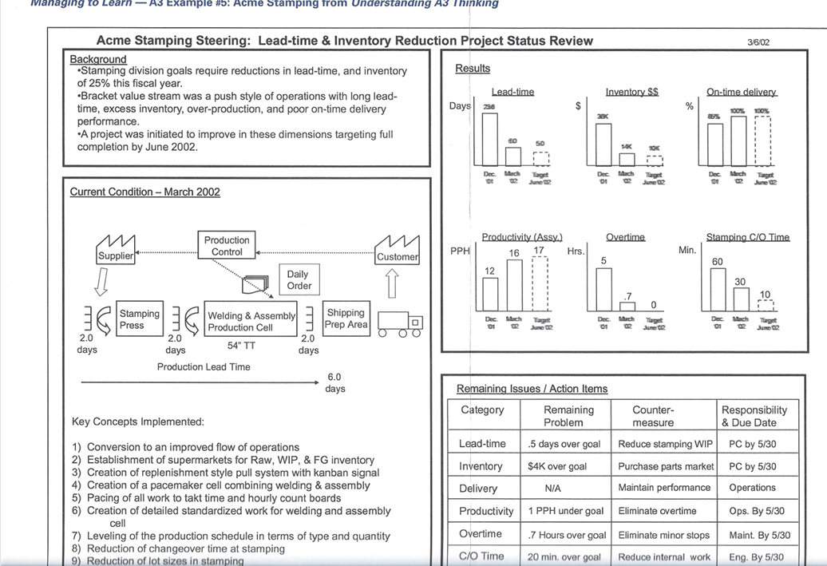
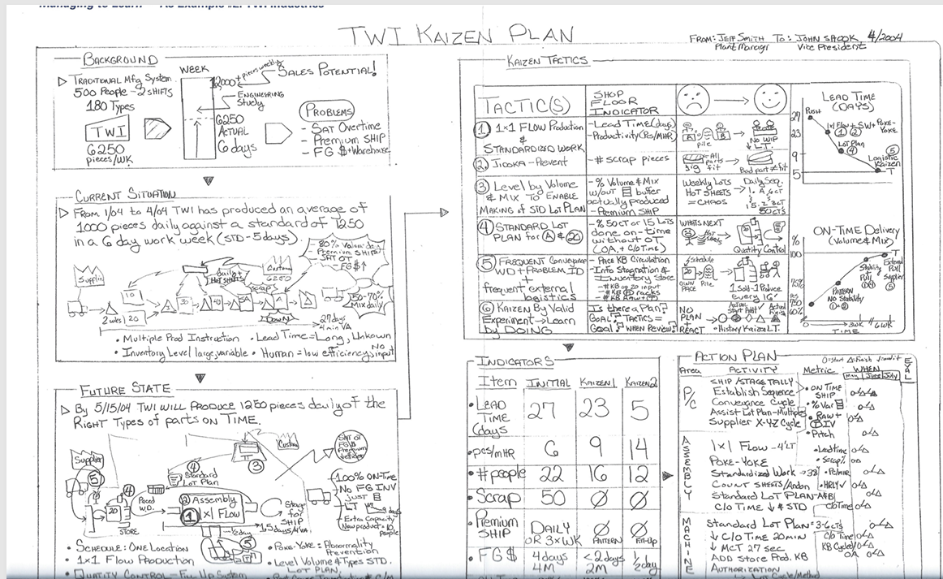

Slide 4
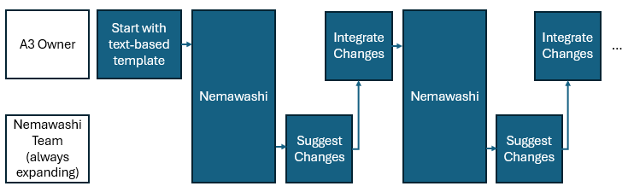
A3 Owner
Start with text-based template
Nemawashi
Integrate Changes
Nemawashi
Integrate Changes
…
Nemawashi Team
(always expanding)
Suggest Changes
Suggest Changes

Slide 5
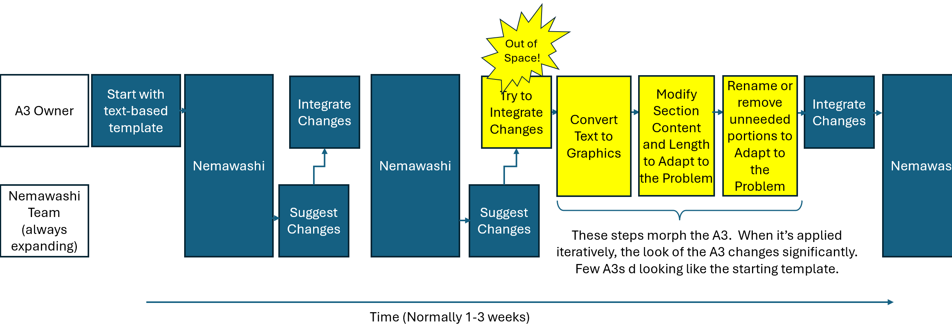
Out of
Space!
A3 Owner
Start with text-based template
Nemawashi
Integrate Changes
Nemawashi
Try to Integrate Changes
Convert Text to Graphics
Modify Section Content and Length to Adapt to the Problem
Rename or remove unneeded portions to Adapt to the Problem
Integrate Changes
Nemawashi
Nemawashi Team
(always expanding)
Suggest Changes
Suggest Changes
These steps morph the A3. When it’s applied iteratively, the look of the A3 changes significantly. Few A3s d looking like the starting template.
Time (Normally 1-3 weeks)

Slide 6
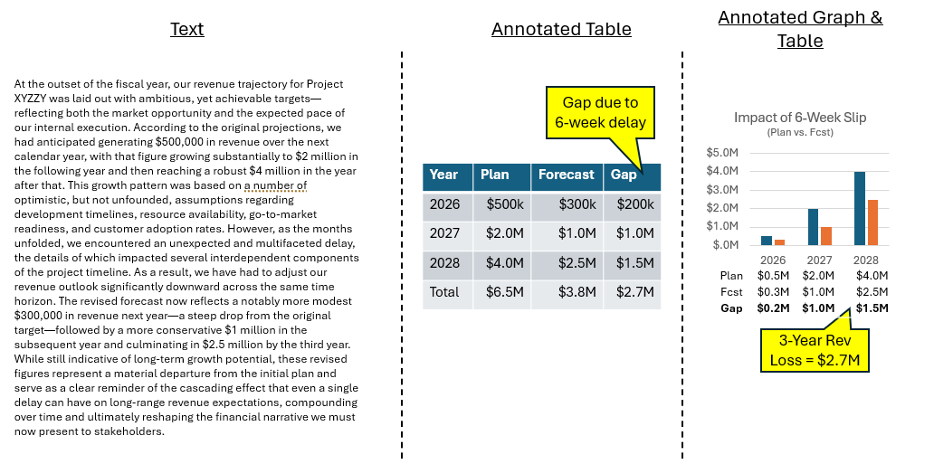
Text
Annotated Table
Annotated Graph & Table
At the outset of the fiscal year, our revenue trajectory for Project XYZZY was laid out with ambitious, yet achievable targets—reflecting both the market opportunity and the expected pace of our internal execution. According to the original projections, we had anticipated generating $500,000 in revenue over the next calendar year, with that figure growing substantially to $2 million in the following year and then reaching a robust $4 million in the year after that. This growth pattern was based on a number of optimistic, but not unfounded, assumptions regarding development timelines, resource availability, go-to-market readiness, and customer adoption rates. However, as the months unfolded, we encountered an unexpected and multifaceted delay, the details of which impacted several interdependent components of the project timeline. As a result, we have had to adjust our revenue outlook significantly downward across the same time horizon. The revised forecast now reflects a notably more modest $300,000 in revenue next year—a steep drop from the original target—followed by a more conservative $1 million in the subsequent year and culminating in $2.5 million by the third year. While still indicative of long-term growth potential, these revised figures represent a material departure from the initial plan and serve as a clear reminder of the cascading effect that even a single delay can have on long-range revenue expectations, compounding over time and ultimately reshaping the financial narrative we must now present to stakeholders.
Gap due to 6-week delay
Year | Plan | Forecast | Gap
2026 | $500k | $300k | $200k
2027 | $2.0M | $1.0M | $1.0M
2028 | $4.0M | $2.5M | $1.5M
Total | $6.5M | $3.8M | $2.7M
Plan | $0.5M | $2.0M | $4.0M
Fcst | $0.3M | $1.0M | $2.5M
Gap | $0.2M | $1.0M | $1.5M
3-Year Rev Loss = $2.7M

Slide 7
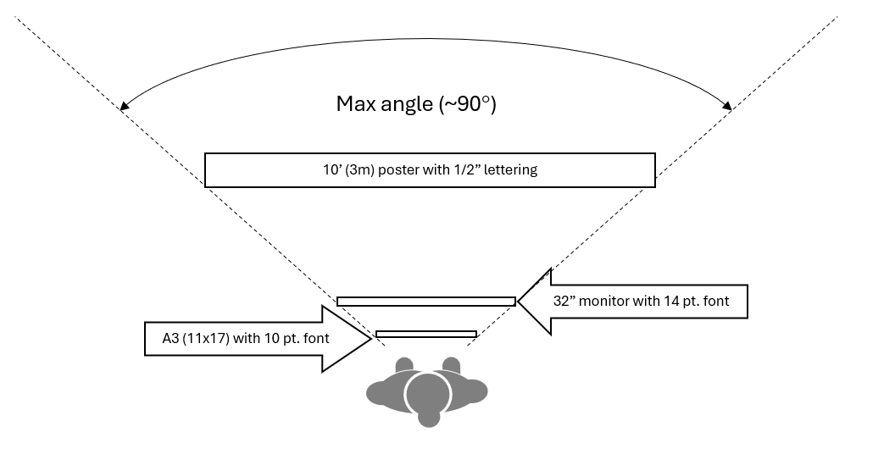
Max angle (~90°)
10’ (3m) poster with 1/2” lettering
32” monitor with 14 pt. font
A3 (11x17) with 10 pt. font

Slide 8
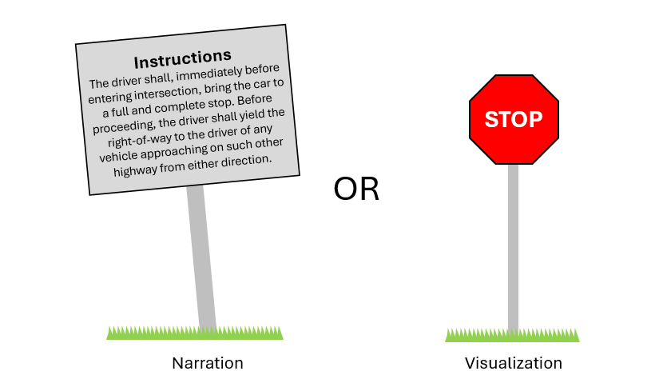
Instructions
The driver shall, immediately before entering intersection, bring the car to a full and complete stop. Before proceeding, the driver shall yield the right-of-way to the driver of any vehicle approaching on such other highway from either direction.
STOP
OR
Narration
Visualization

Slide 9
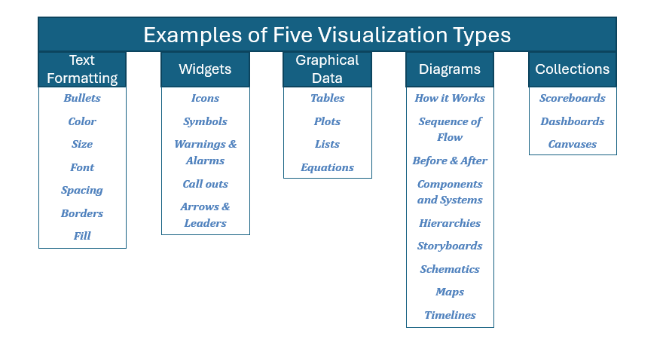
Examples of Five Visualization Types
Text Formatting
Widgets
Graphical Data
Diagrams
Collections
Bullets
Color
Size
Font
Spacing
Borders
Fill
Icons
Symbols
Warnings & Alarms
Call outs
Arrows & Leaders
Tables
Plots
Lists
Equations
How it Works
Sequence of Flow
Before & After
Components and Systems
Hierarchies
Storyboards
Schematics
Maps
Timelines
Scoreboards
Dashboards
Canvases

Slide 10
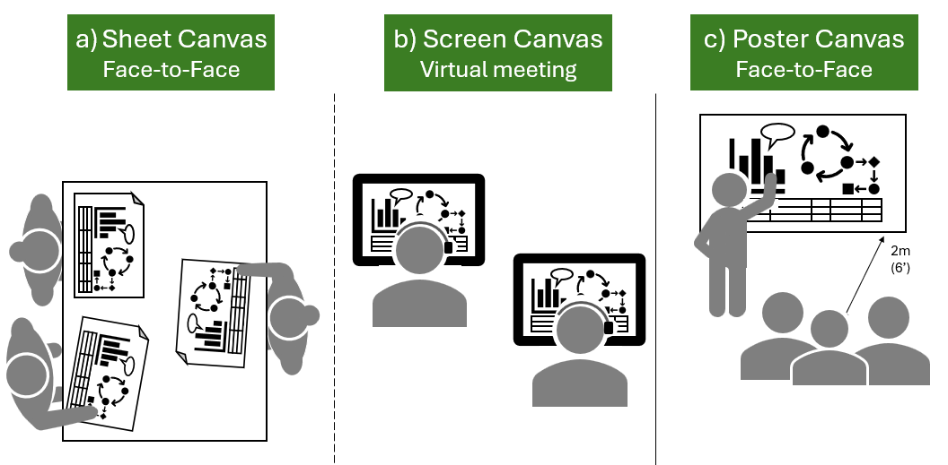



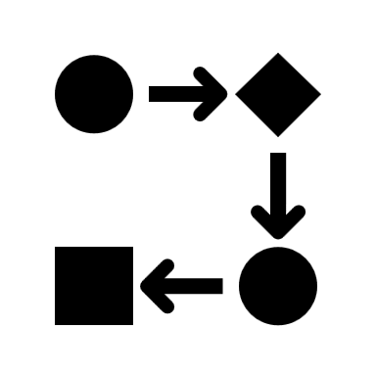
Sheet Canvas
Face-to-Face
b) Screen Canvas
Virtual meeting
c) Poster Canvas
Face-to-Face
2m
(6’)

